Slide 1

Year 6
Curriculum Information Evening

Slide 2
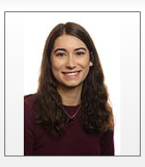

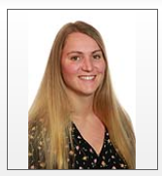

Adults
6A
Teacher: Miss Adams
Teaching Assistants: Mrs Holloway and Mrs Croxford
6L:
Teacher: Miss Leney
Teaching Assistants: Mrs Davies, Mrs Mainwaring-Green, Mrs Holloway

Slide 3
General Information
Communication
Please speak to teachers at dismissal or email info.saxon@lumenlearningtrust.co.uk.
Google Classroom is to be used for submitting learning within the school day, all queries should be sent to the info account.
General
Uniform (silver stud earrings, tie, black school shoes, small green hair band, green jumper/cardigan, labelled uniform/bag/water bottle).

Slide 4
Curriculum
Cross curricular learning opportunities
Debating and further responsibilities
Positions of Responsibilities
Zones of regulations
Stay on Green
5Rs
Autumn Term- World War Two
Further curriculum information on the framework provided.

Slide 5
Expectations
In class
Spellings
Reading 10 minutes each day
Home learning
Reading
Maths facts
Weekly CGP Books
TTRS and maths website.
Equipment:
PE Kit on Thursdays

Slide 6
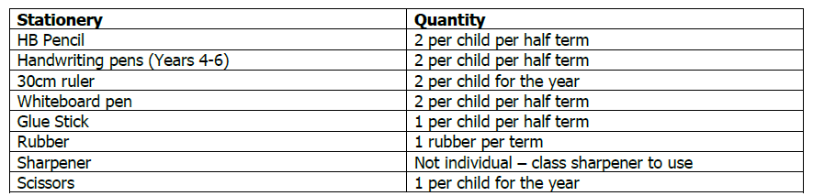
Stationery
Teachers will be labelling all items of school stationery and monitoring how much each child uses so that we can continue to ensure we do not overspend on stationery. The table below is an example of what each child will receive.

Slide 7
Trips and Events
Autumn term:
Poetry Day – Thursday 3rd October
SSA Firework Night – Friday 25th October
Progress Meetings – Wednesday 6th and Thursday 7th November
Anti-bullying Day – Monday 11th November
World Kindness Day – Wednesday 13th November
Bristol – Tuesday 15th – Friday 18th
Parental Engagement – 4th October
Christmas Market and Carols – Friday 13th December
Spring term:
Maths Day – Wednesday 5th February
Progress Meetings – Tuesday 11th and 12th February
World Book Day Celebrations – Thursday 6th March
Y6 SATs Information Meeting – Monday 11th March 3:30pm
Summer term:
SATs breakfast begins – Friday 9th May
SATs – Monday 12th May
Sports Day – Tuesday 3rd June
Year 6 Secondary school visit – TBC
Year 6 Production – Thursday 10th and Friday 11th July
Leavers’ Picnic – Thursday 18th July 2pm
Leavers’ Disco – Thursday 17th July 6-8pm

Slide 8
Assessment Week
Daily short papers throughout the year.
Maths: 2x Reasoning Paper and 1x Arithmetic.
English: Reading paper and SPAG paper.
Take place once every term in the Autumn and Spring term.
Revision Weeks
SATs – Week beginning Monday 12th May
SATs information evening - TBC

Slide 9
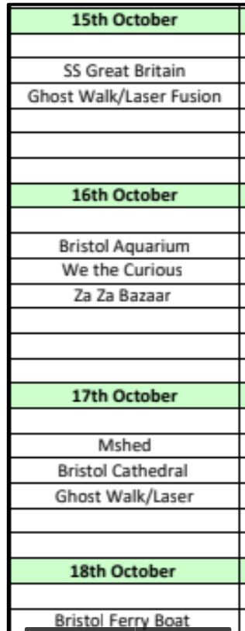
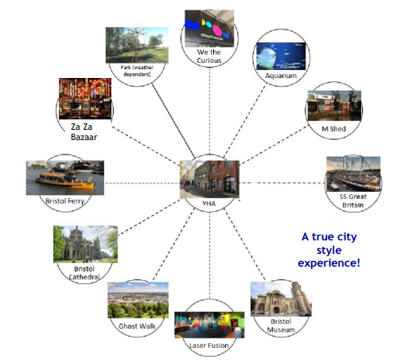
Year 6 Residential – Bristol

Slide 10
Transition
Children will be supported with their transition to secondary school in the second half of the Summer Term.
Stepping on up and Smart Moves programmes will be used.
You will need to have applied for a secondary school pace by Tuesday 31st October.

Slide 11
Any questions?
Thank you!

