Slide 1

Year 1
Click this icon to hear audio.
Introduction
2024/2025

Slide 2
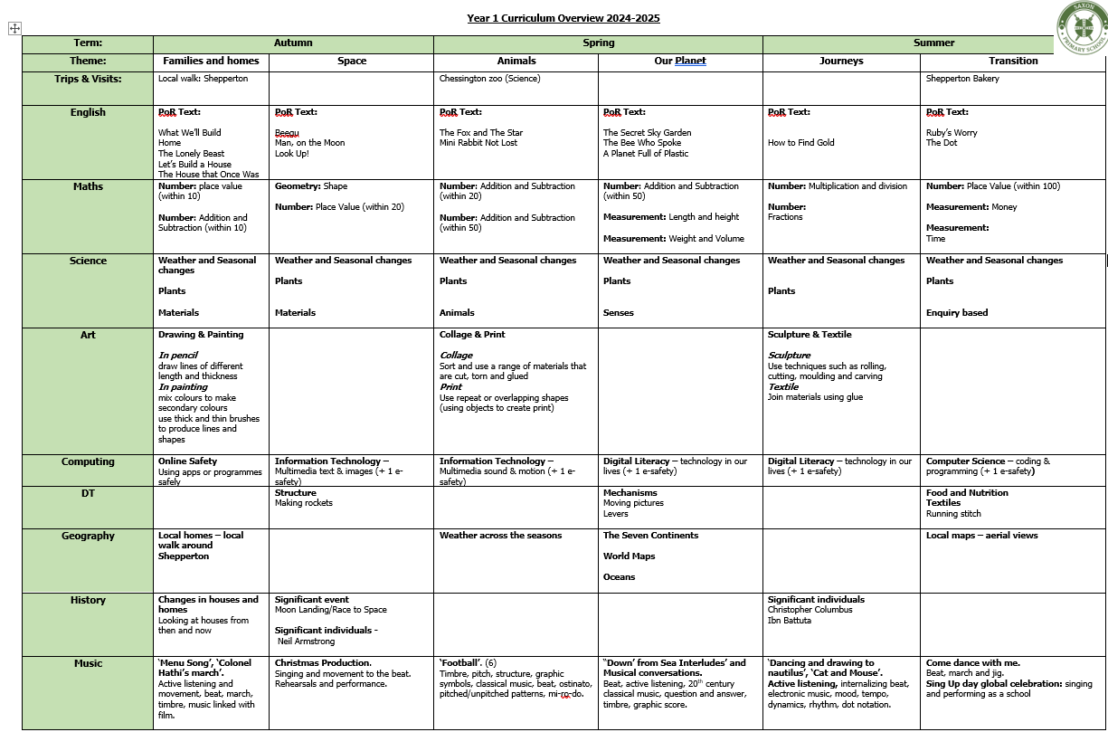
Curriculum Overview

Slide 3
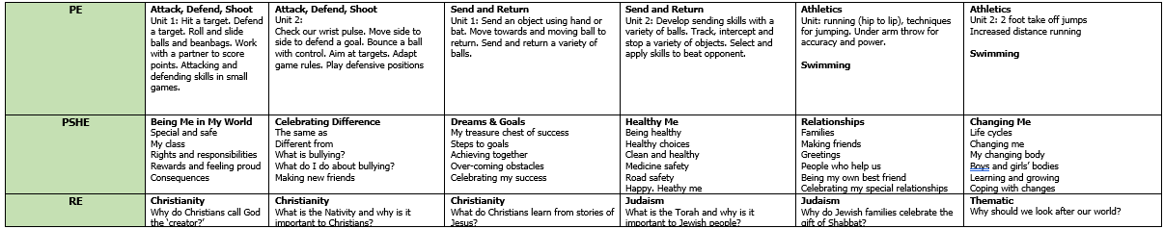
Curriculum Overview
Continued

Slide 4
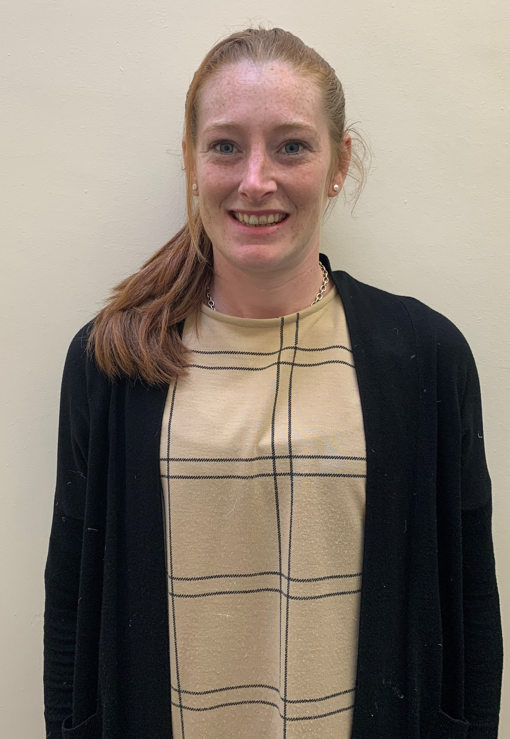
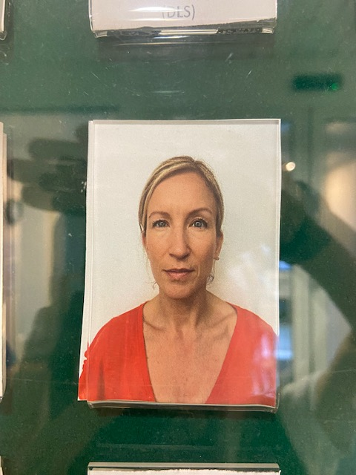
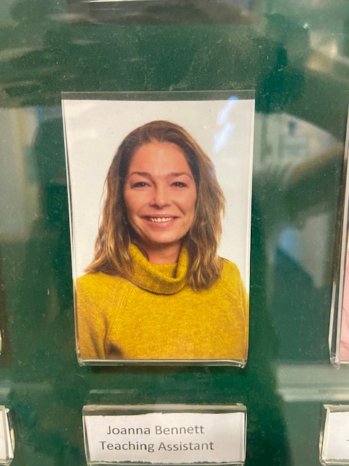
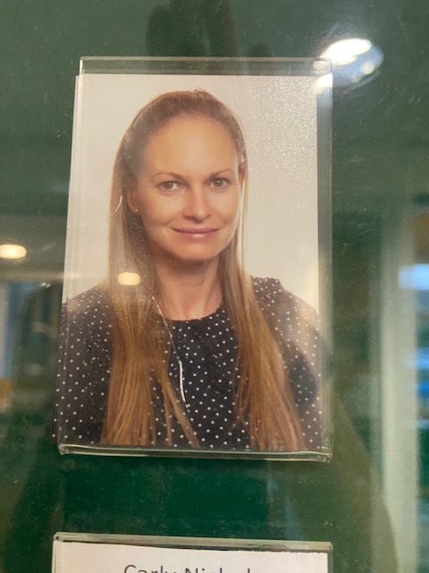
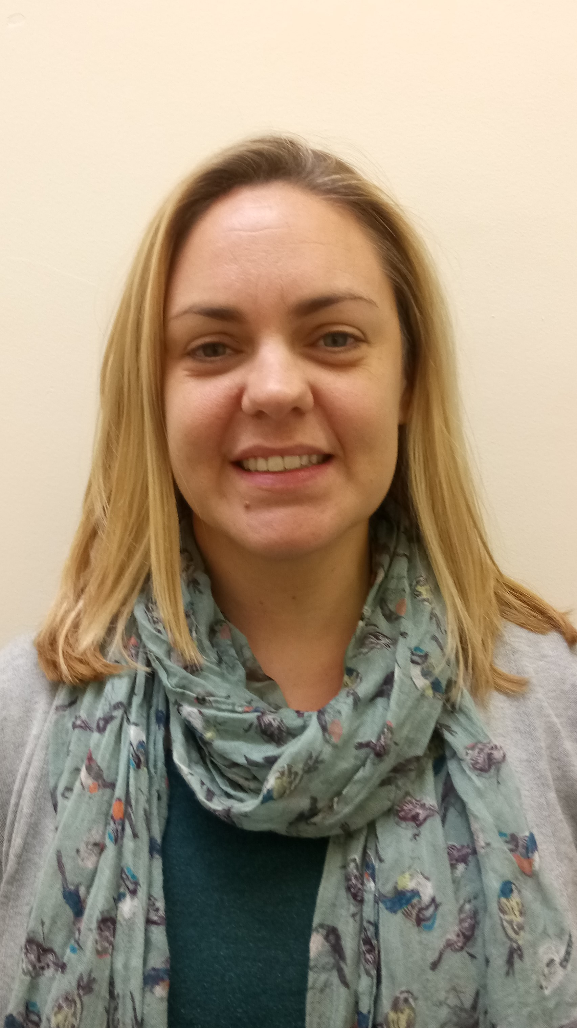
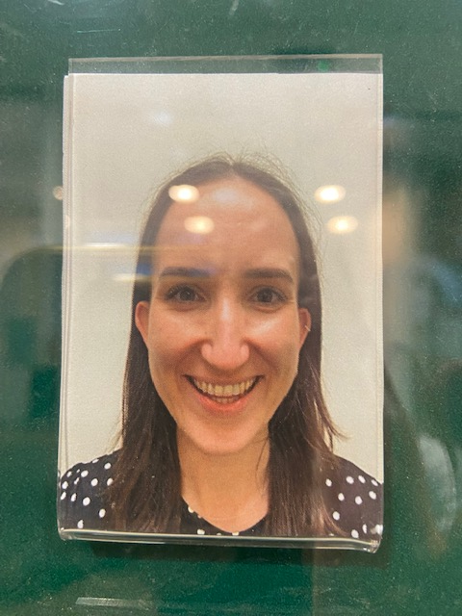
Year 1 Staff
1A
Mrs Atkinson – Class Teacher
Miss Bennett
Miss Johnson
Miss Nicholls
1S
Miss Skulczuk – Class Teacher
Mrs Davison

Slide 5
A Day in Year 1…
8:30-8:50 – Morning Task
8:50-9:00 – Registration
9:00-9:20 – Phonics
9:20 – 10:30 – Guided Group Teaching & Free Learning
10:30 – 10:45 – Break & Snack
10:45-11:00 – English
11:00- 11:55 – Guided Group Teaching & Free learning
11:55 – 1:15 – Lunch
1:15 – 1:45 – Maths
1:45 – 2:30 – Guided Group Teaching & Free Learning
2:30 – 3:00 - Foundation
3:00 – 3:15 – Story Time
3:15 – Home!

Slide 6
Reading
Small groups read twice a week with the teacher / TA.
Reading levels are assessed every 6 weeks.
The class read stories together regularly.
Daily reading at home is vital to fluency, practicing phonics, decoding and to develop a love of reading.
Book packs are changed every week; they will go home on a Friday and come back to school on a Wednesday.

Slide 7
Maths
In Year 1, children will focus on understanding number, developing reasoning and problem solving. Children will also learn about shape, space and measure.
Children will participate in daily Mastering Number Maths meetings.
Key facts to practise
Counting to 100 (by the end of Year 1)
Counting forwards and backwards in 1s, 2s, 5s and 10s
Number bonds to 10 and 20
Doubles and halves
Numbots
Maths website https://saxonmaths.weebly.com/

Slide 8
Home Learning
Daily Reading
  Recorded in reading record
Weekly Maths Facts
Phonics
  Weekly phonics sounds and words to practise reading at home

Slide 9

Library
Both classes will visit the library bus.
Children can bring their book in to be
changed or they can keep them and just visit the library bus.
They need to return their book to be able to get a new book out from the Library Bus.

Slide 10
P.E.
P.E. Days: Monday Afternoon
Children will be expected to arrive at school in their full PE kit on their PE days.
Swimming: Summer term

Slide 11
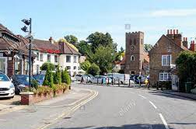
Trips
Chessington Zoo (TBC)
Other/Local trips (TBC):
Local walk (Houses and Homes)
-Local Bakery visit (maths, coins).

Slide 12
Phonics Screening
This takes place in the Summer Term.
We will start the year by reviewing Phase 3 (following the Little Wandle Letters and Sounds Scheme).
More information will be provided on the Phonics Screening Check closer to the time.

Slide 13
Questions

