Slide 1

Reception at
Saxon Primary School
2023-24

Slide 2
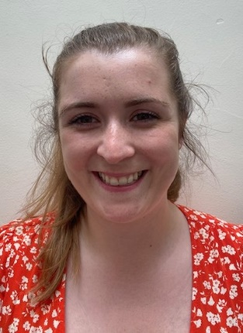
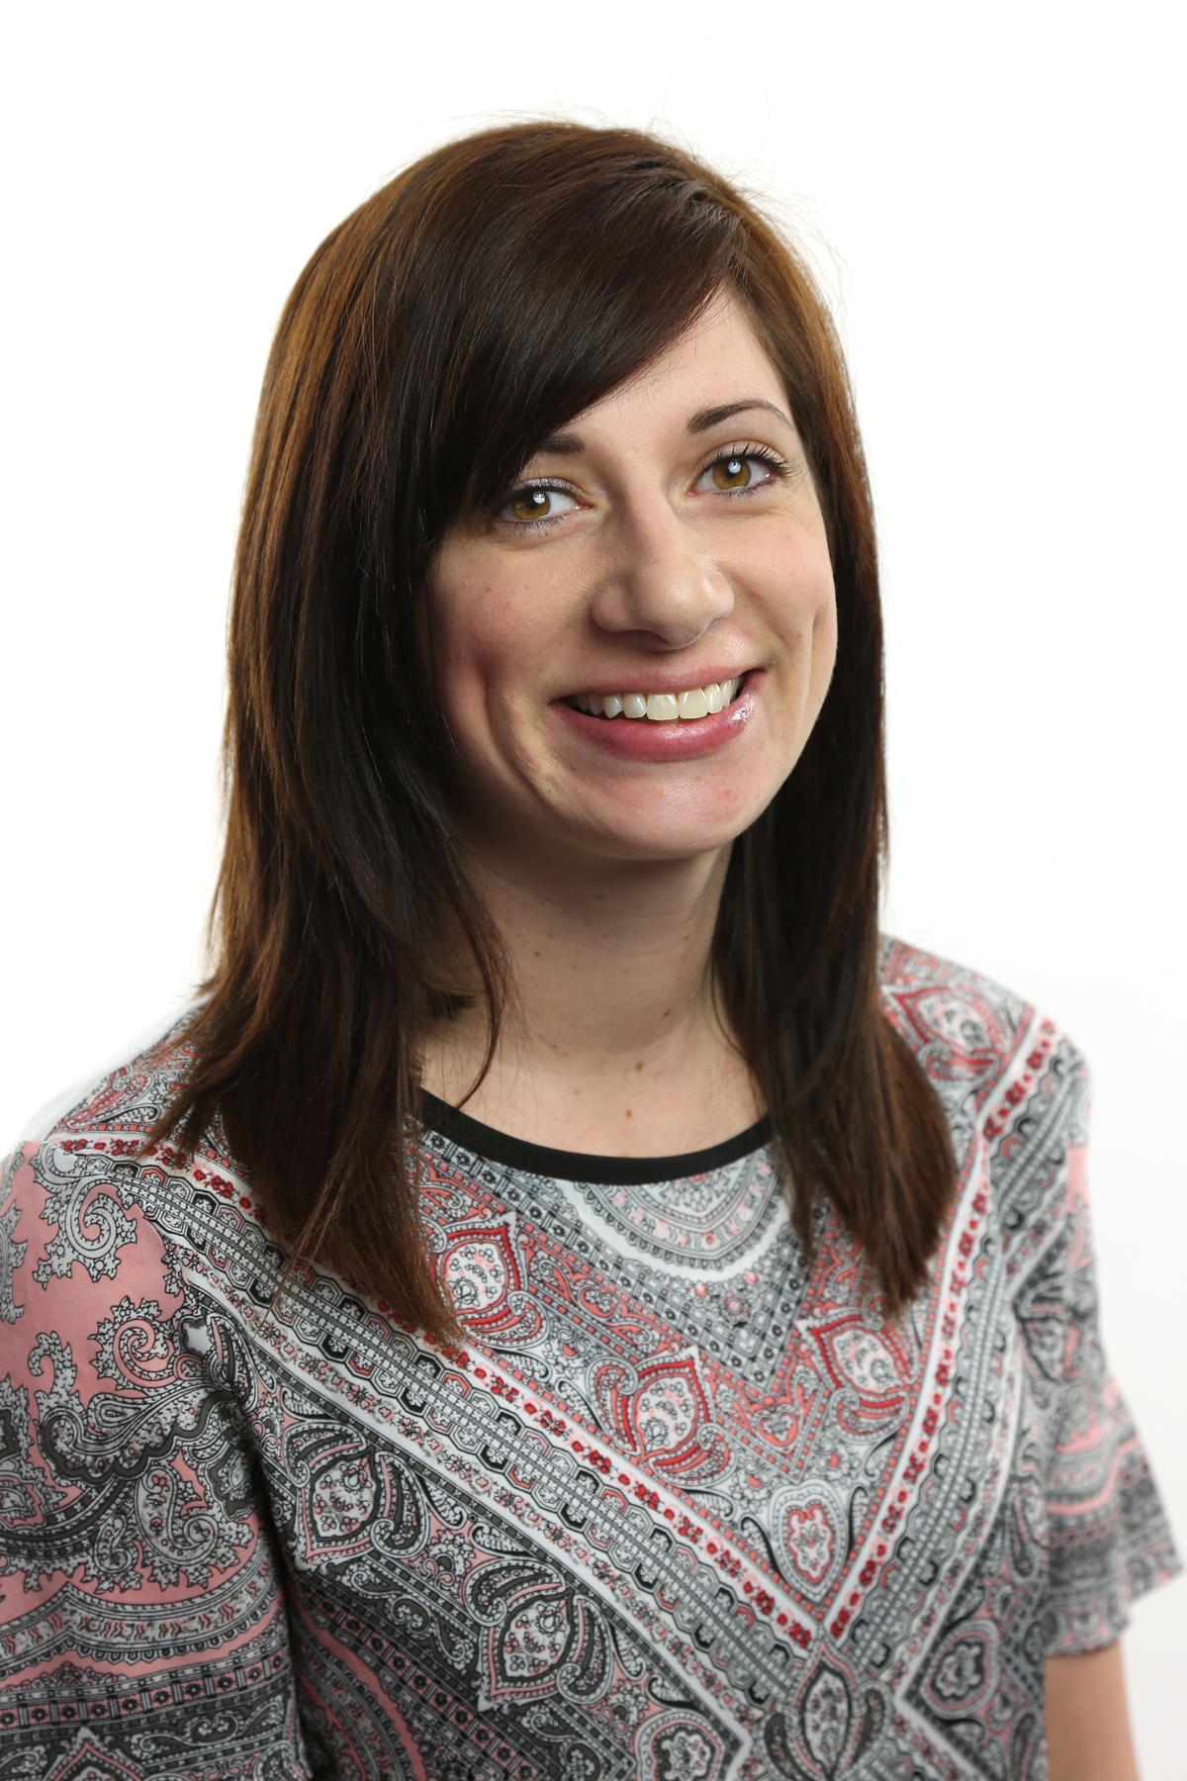
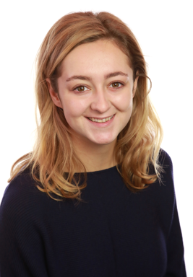
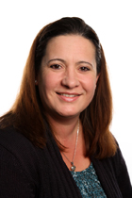
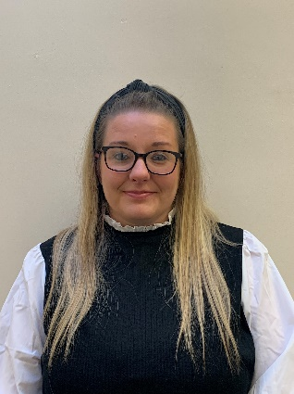
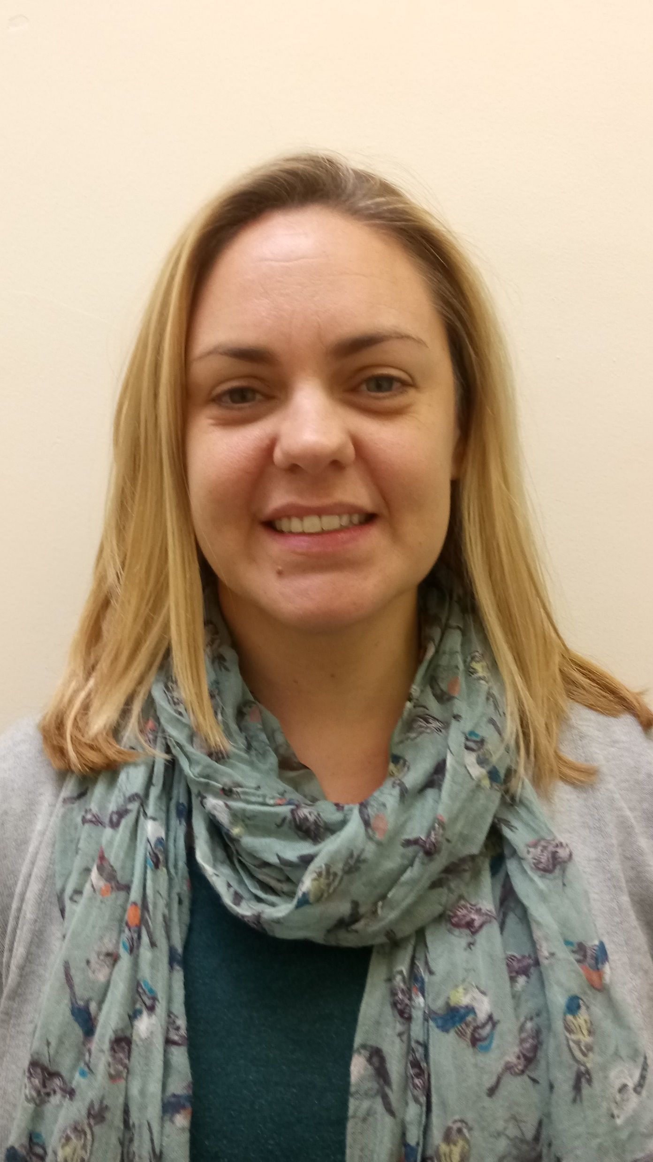
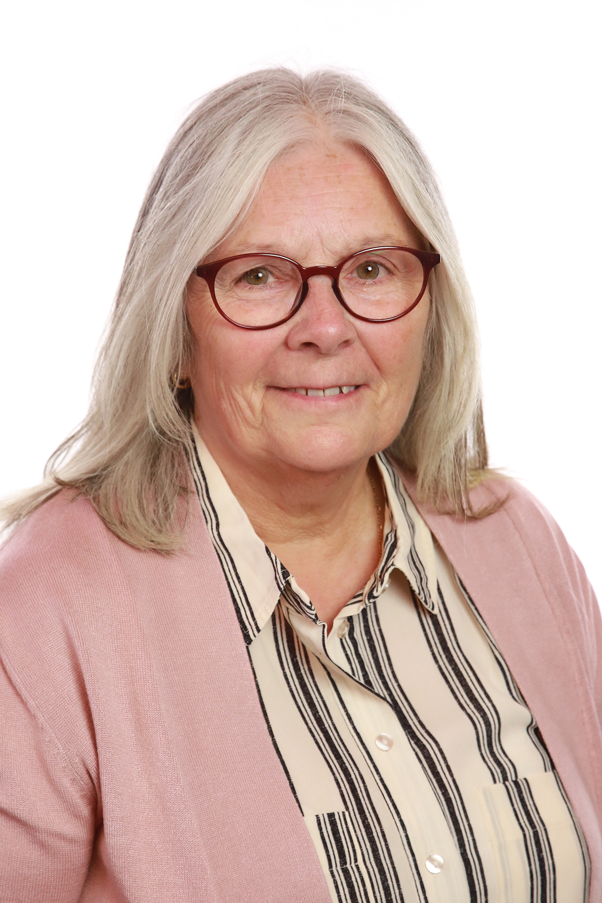
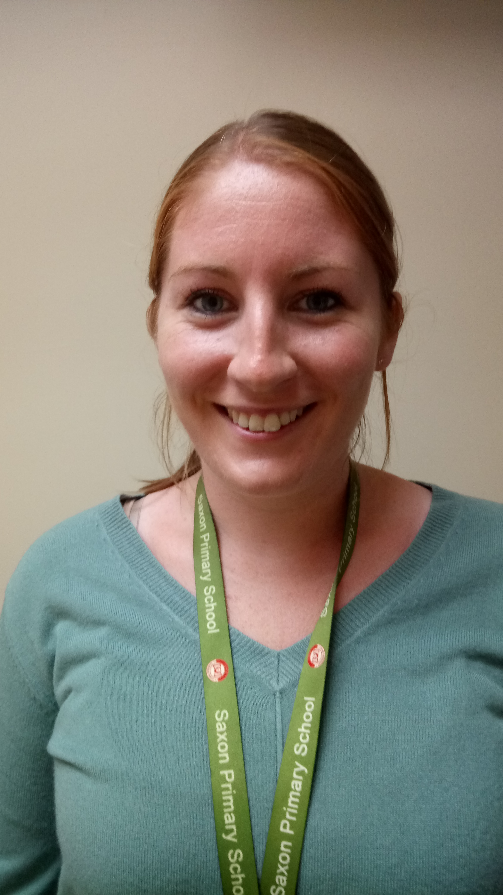
RLM
RB
Mrs Lewis(Mon – Wed)
Mrs Morley (Wed – Fri)
Mrs Cogbill (AM)
Mrs Croxford (PM)
Mrs Davison (Wesnesday PPA)
Miss Brown
Mrs Slatter (AM & PPA Cover Weds PM)
Mrs Cheeseman (PM)
Our Reception environment is fluid and therefore your child will become very
familiar with all of these adults.

Slide 3
The Early Years Foundation Stage at Saxon
What is the EYFS?
The Early Years Foundation Stage statutory framework
A government document that all schools and Ofsted registered early years providers in England must follow.
Sets standards for the learning
The framework builds on the foundations set at Nursery.
What does the EYFS curriculum look like?
Seven areas of learning and development, separated into the ‘prime’ and ‘specific’ areas.
Communication and Language (CL)
Personal, social, and emotional development (PSED)
Physical development (PD)
Literacy
Mathematics
Understanding the world
Expressive arts and design
The Reception year is all about forming positive relationships and instilling a love of learning, playfully.
At the end of Reception, the children will be assessed against ‘Early Learning Goals’ in all of these areas. The assessments will inform their next teacher of strengths and goals to work on.

Slide 4
The Early Years Foundation Stage at Saxon (cont.)
Indoor and outdoor environments provide resources, activities and learning opportunities meet each child’s unique requirements.
High quality texts selected from the ‘Power of Reading’ scheme to support talk and inspire play.
Curriculum is responsive and flexible to follow the children’s interests. Our key philosophy is ‘high engagement results in high achievement’.
Majority of our learning is play based but we also plan some guided activities that all children access with an adult throughout the week.
Learning is recorded by adults on observation slips and kept in individual folders. Independent writing, maths etc, is also stored within the folder to build up a broad picture of your child’s development. Adult led learning (‘guided teaching’) is kept in a book.
You will be able to view your child’s learning at our parent consultation evenings (first of these is w/c 30th October) and at the end of the year.

Slide 5
What does a typical day in Reception look like?
8.30 – Free Learning (or ‘choosing’ time)
8.50 – Registration & lunch selection
9.00 – ‘Wake and Shake’ movement break
9.05 – Phonics
9.20 – Free Learning
An adult guided activity will also take place during this time.
The second adult will play alongside and observe children within the provision to establish next steps and promote deeper level learning through questioning and prompts.
10.00 – Snack
10.10 – English/Maths input
10.20 – Free Learning
11.10 – Tidy up & prepare for lunch
11.30 – Lunch in the hall
12.15 – Playground
1.15 – Registration
1.20 – English/Maths/PSHE input
1.30 – Free Learning (an adult will also hear readers during this time. This may be a teacher or a TA). Rolling snack.
2.30 – Tidy up
2.45 – Prepare for home time, story, songs

Slide 6
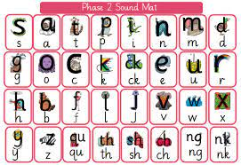
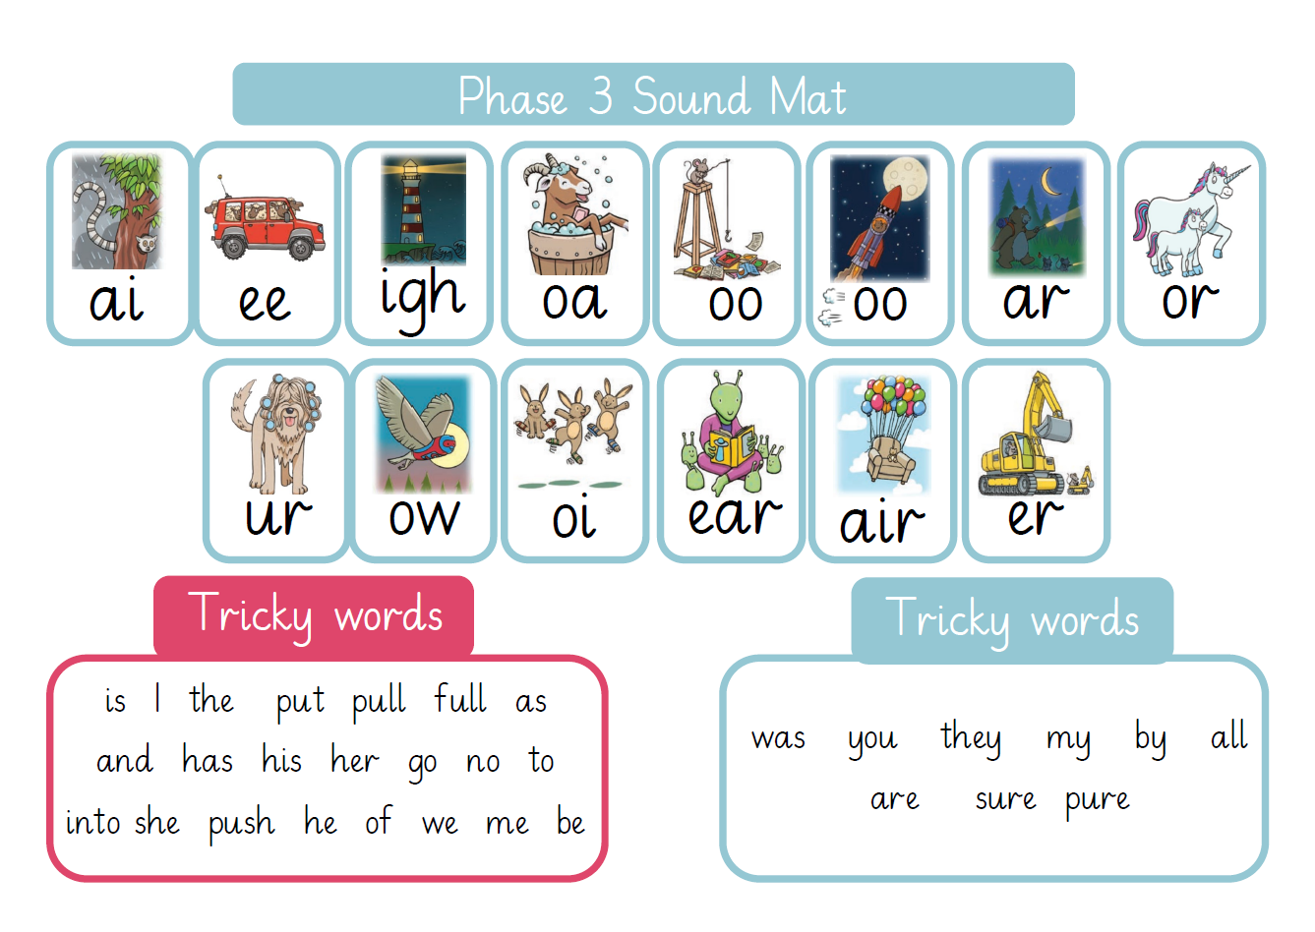
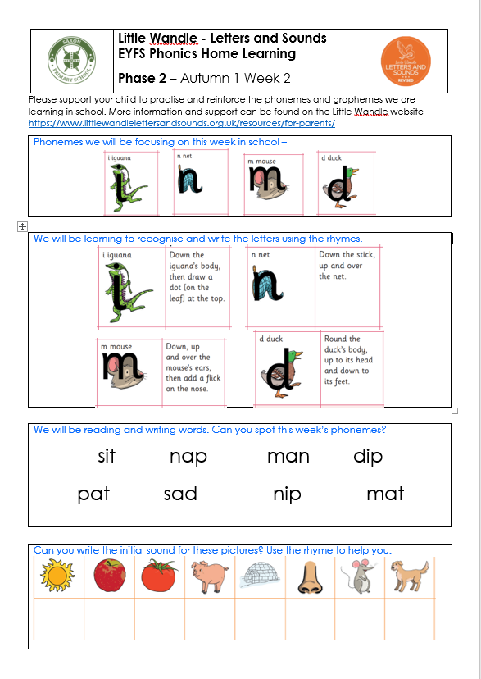

Phonics and Early Reading
‘Little Wandle Letters and Sounds’ phonics programme.
Each week we introduce 4 new sounds. We have taught the following sounds so far s, a, t, p, i, n and m.
Weekly homework sheet will have the sounds previously taught
Historically children that have consistently consolidated their learning at home have been more confident in their reading at the end of Reception.
We strongly encourage bedtime stories and reading at home.
https://www.littlewandlelettersandsounds.org.uk/resources/for-parents/

Slide 7
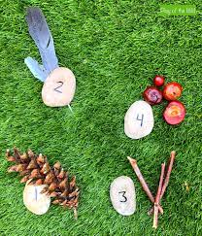

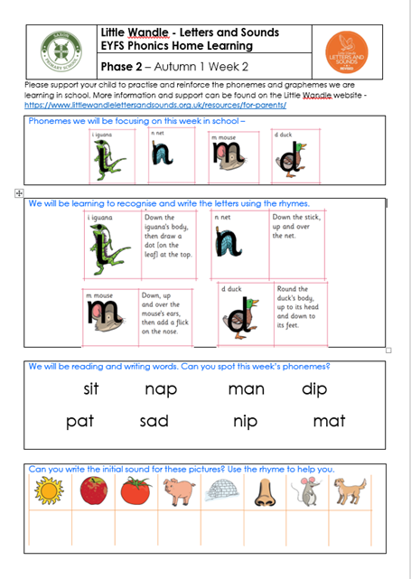

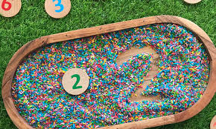
Home Learning & Reading
Home learning
Phonics Sheets
Practical maths (see the Reception newsletter)
Reading books

Slide 8
Additional Opportunities
Throughout your child’s time in Reception, we strive to further develop your child’s cultural capital through a range of trips, visitors and learning experiences. So far this year we have planned:
‘The Jolly Postman’ visit – Christmas
Bus Museum visit – Transport
Fire Brigade Visit – Transport
Forest School
Bocketts Farm trip – Animals and growing
Our smaller, in-school experiences such as dress up days and character visits are subject to change – we will inform you of the details of any events closer to the time.

Slide 9
Stay on Green
Visual behaviour system used across the school.
Children are able to move up and down the colours as and when.
We encourage children to ‘stay on green’ by making ‘green choices’ throughout the day.
Children can earn Green Points for their green choices.
Green Points contribute to earning Green Time on a Friday afternoon when children can vote for their favourite activity to do after lunch.
Moving to Red: consequences.

Slide 10
Communication with Families
We will always inform you of any concerns, bumps or special achievements at pick-up time, though will not be able to provide detailed feedback regularly.
Please see information specific to Reception families in our weekly newsletter. All other notices will be in the whole school newsletter on a Friday.
If you have any questions or concerns, please do contact your child’s class teacher. At drop off, please share any urgent messages with the staff on the gate, who will inform the teacher at 9am.
You can also contact teachers through the school email address or at pick-up time (though please be warned this is a busy time and so you may need to wait a few minutes).
School email –info.saxon@lumenlearningtrust.co.uk

Slide 11

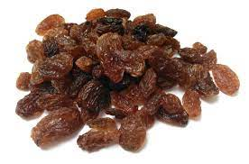
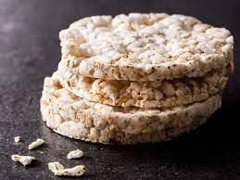
Reminders
Please label all of your child’s uniform
Cool Milk – www.coolmilk.com
Tuesday is PE day
Swimming in the Summer Term
Please send in a named water bottle each day. We do offer the children a healthy snack in the morning but they are very welcome to bring in something from home.
Healthy snack suggestions:
Fresh fruit or vegetables
Dried fruit
Plain rice cakes
Bread sticks
Yoghurt tube
Plain crackers
A pitta bread or wrap (with no filling)
No nuts please!

Slide 12
How can you get involved?
The SSA always appreciate parents help. If you would like to help please contact Mrs Vaughan (Assistant Head) or the SSA on: ssa.saxon@lumenlearningtrust.co.uk
Home School Link Worker
Shelly Lumb is our Home School Link Worker is always here to support any parents or children with any worries or difficulties at home.

Slide 13
Thank you for coming!

