Slide 1

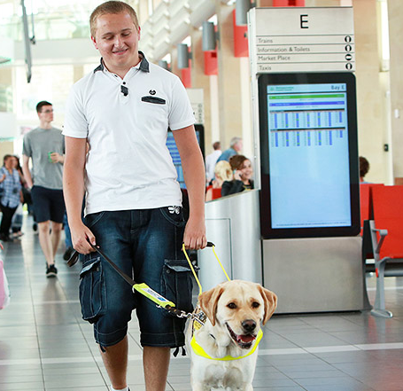

Slide 2
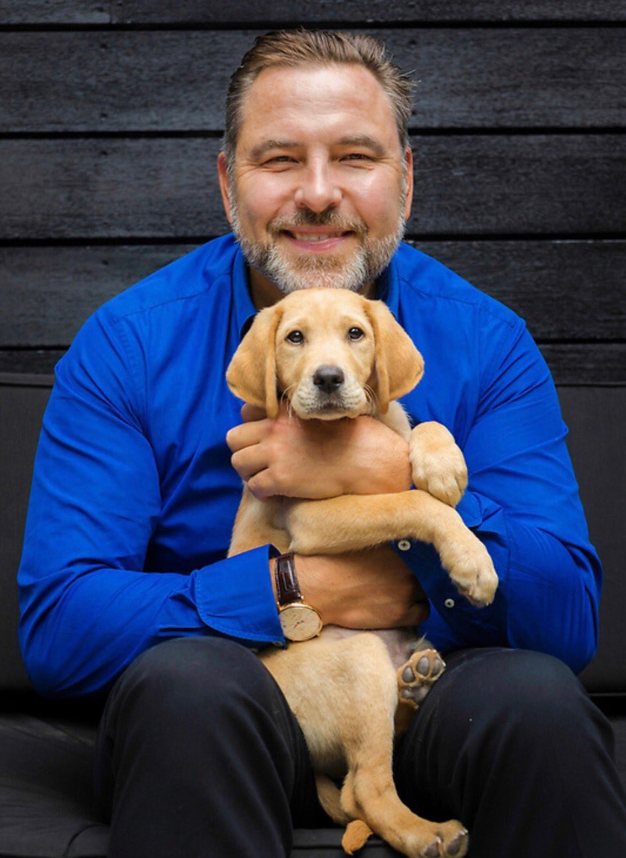
David Walliams is a big supporter of Guide Dogs. A couple of years ago, he had a special guide dog puppy named after him.
“This is the 10,000th Guide Dog puppy. His name is David, and I am proud to say they named him after me. It is an honour to be involved with the life changing charity.”

Slide 3
Activity 1: What Does a Guide Dog Do?
Key Vocabulary
Guide dog, crossing kerb, obstacles, corner, brave, confident
Video to Watch
https://youtu.be/6Ad798HWGEA
Introduction
A guide dog enables its blind or partially-sighted owner to get around safely and independently. It guides its owner in a straight line, unless told otherwise, avoiding obstacles – including those at the owner’s head height. It will stop at kerbs and steps and find doors, crossings and places that are visited regularly. It will guide its owner across the road, but it is the owner who decides where and when to cross safely

Slide 4
Video: Key Questions
What does Alma do when she comes to a corner?
What does she do when she comes to a kerb?
What does she do when she comes to steps/stairs?
What does Alma do when there are people around?
Did anybody spot any obstacles? They may have noticed A-boards outside shops, bikes propped against shop windows etc.
What has Alma the guide dog had to avoid?
Where do Alma and Nicky end up?

Slide 5
Activity 2: How are Guide dogs trained?
Key Vocabulary
Puppy walker, training, qualities, volunteer
Video to Watch
https://youtu.be/AHXMePThvgw
Introduction
A guide dog needs to have very special training to do his/her job to the high standards required. It starts when they are very young.

Slide 6
Video: Key Questions
The life of guide dogs
How does Retinitis pigmentosa affect sight?
How do guide dogs help their owners?
Guide dog puppies
What happened when the puppies were six to eight weeks old?
What is the volunteer who looks after the pup known as?
What sort of things are the puppies introduced to? Why are these important?
Guide dogs in training
What colour harness do the dogs wear at the Guide Dog Training School?
What do the dogs do when they reach an obstacle?
How are the dogs rewarded when they get things right?
Matching the dog with their owner
What forms of transport does Chad need to be able to go on?
Where does Chad take Dave to every day?
How long did Chad and Dave train together for?

Slide 7
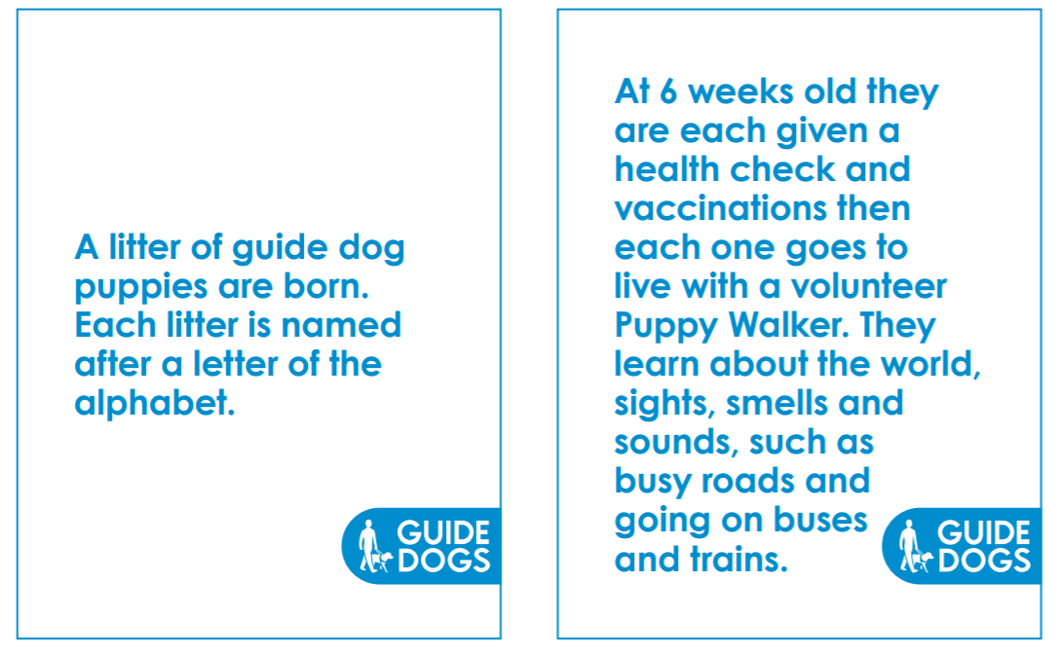
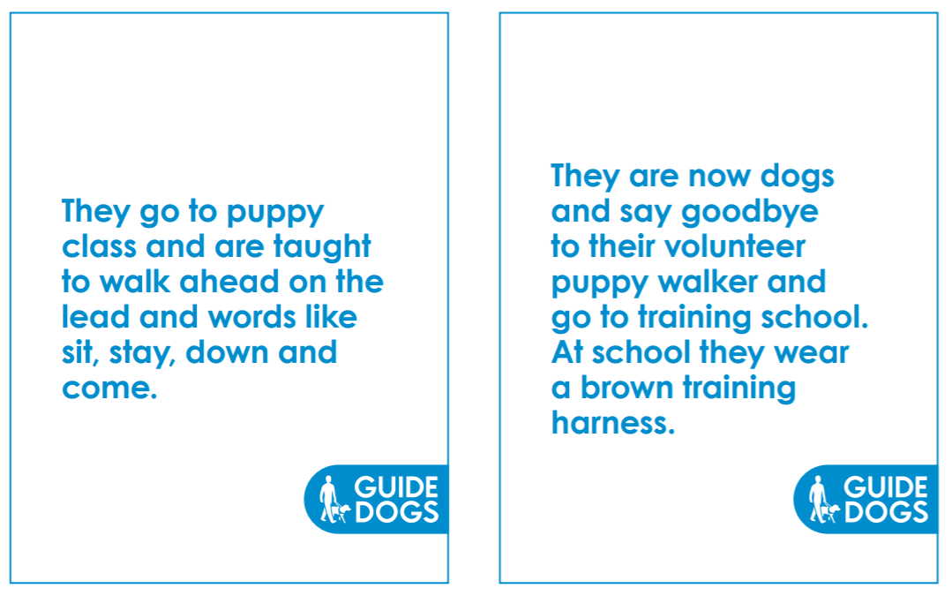
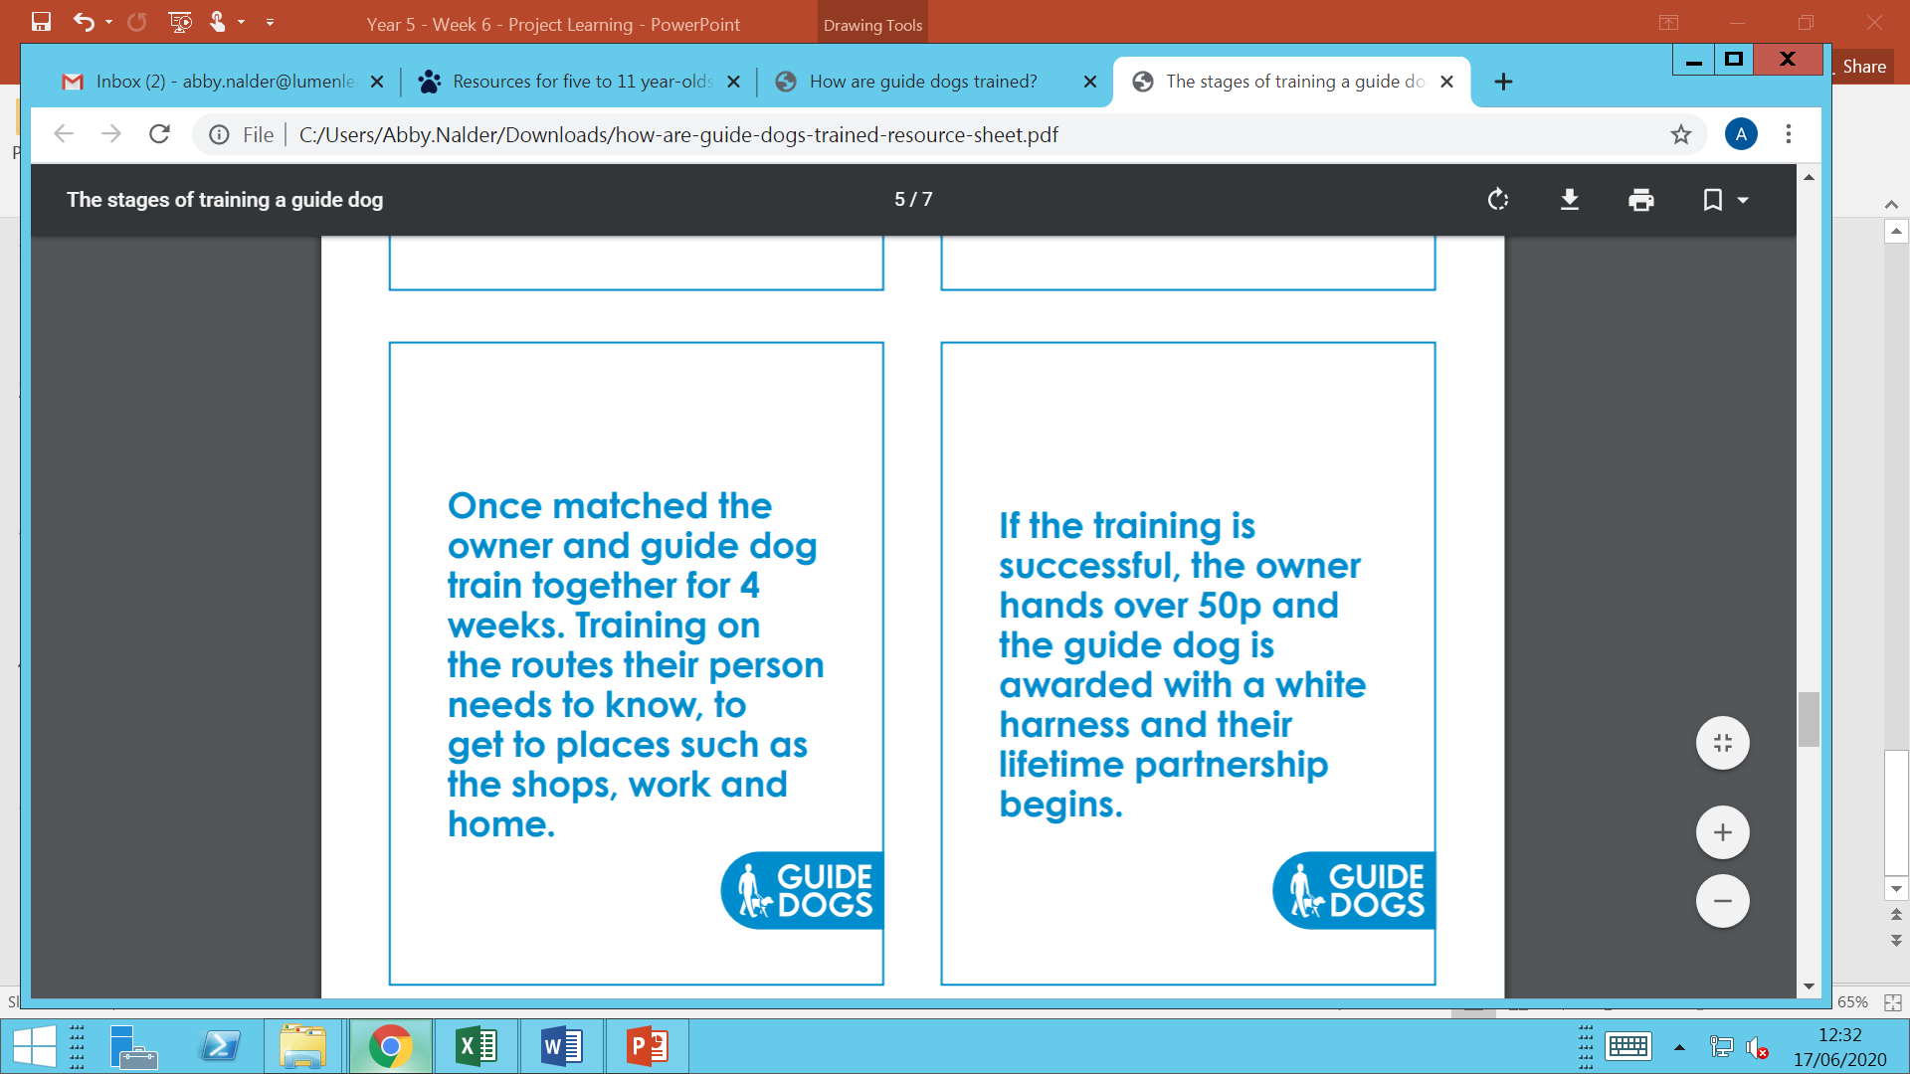
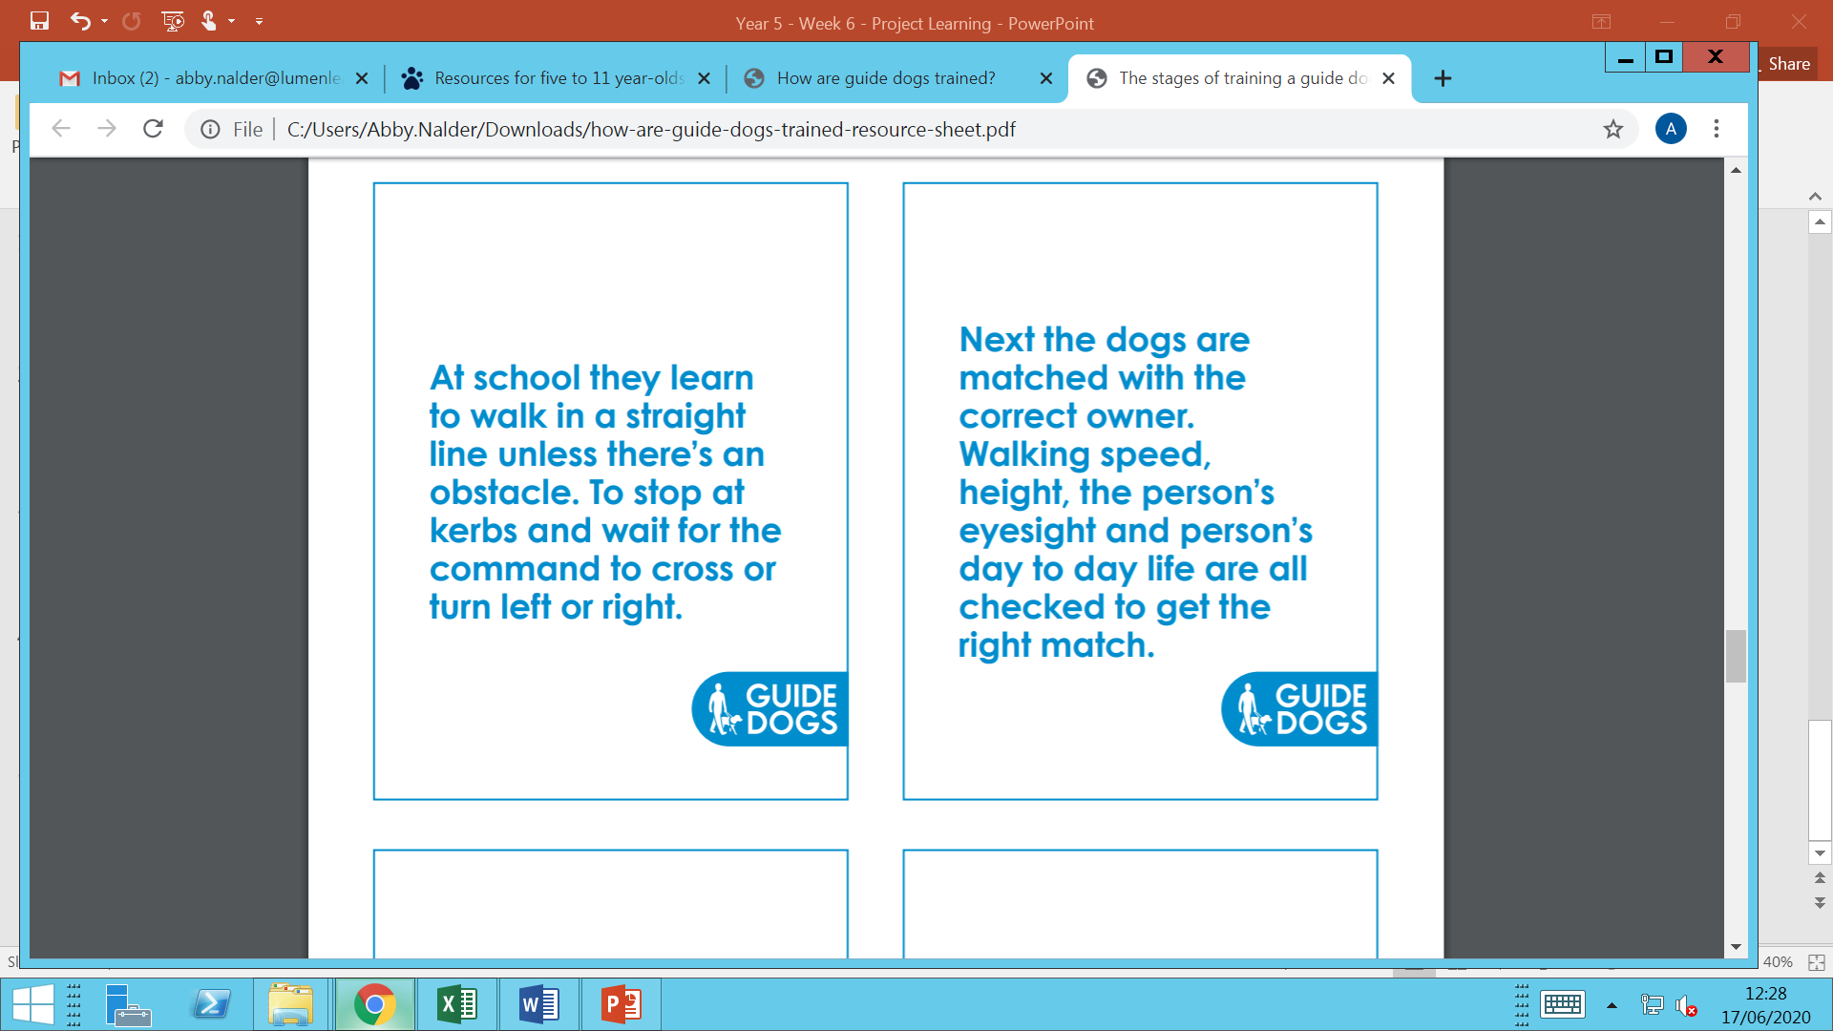

Slide 8
Activity
Imagine that The Guide Dogs for the Blind Association are looking for a puppy to train as a guide dog.
Think back to the video and class activity for the qualities needed for a guide dog.
Imagine you are a puppy and fill in the application to become a guide dog.
First of all come up and choose the dog they would like to be from the Our Breeds poster on the next page and write this information along with their name.
Then describe yourself and explain why you should be considered for this important job. Think about the things the puppy would already be good at.

Slide 10
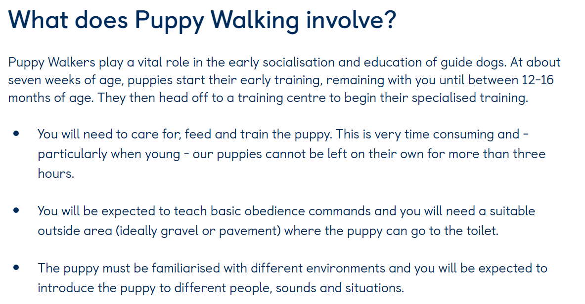
Activity
Imagine you are one of the puppy walkers and write a diary about a recent experience, that you and your guide dog have experienced such a day at the seaside or travelling on a bus or train.
Puppy Walker Videos
https://www.youtube.com/watch?
v=idmcj0ky7Fg
https://youtu.be/zgUceoNNF-g

Slide 11
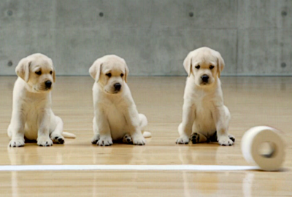
Now you have learnt all about guide dogs, enjoy this very cute video of the guide dog puppies working on the Andrex advert!
https://www.youtube.com/watch?v=R-IFWxiTlOo

