Slide 1

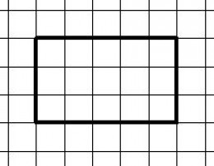
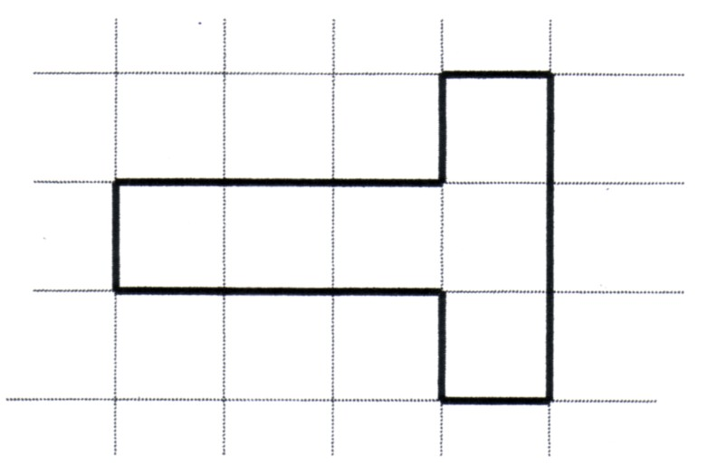
Introduction: Discussion Questions
What is perimeter?
How can you calculate the perimeter of different shapes?
What is area?
How can you calculate the area of different shapes?
How would you calculate the perimeter of the two shapes on the left?
How would calculate the area of the two shapes on the left?
When you write your answer for perimeter, what units do you need to include?
When you write your answer for area, what units do you need to include?

Slide 2
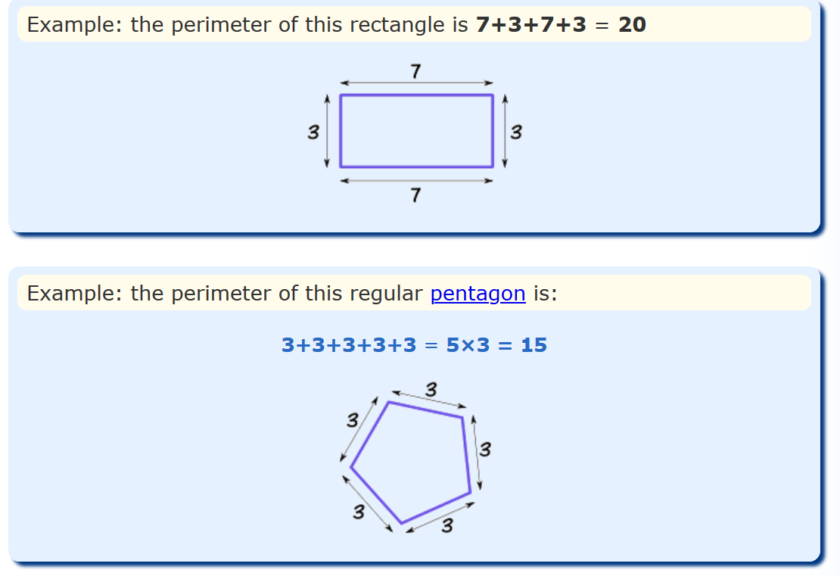
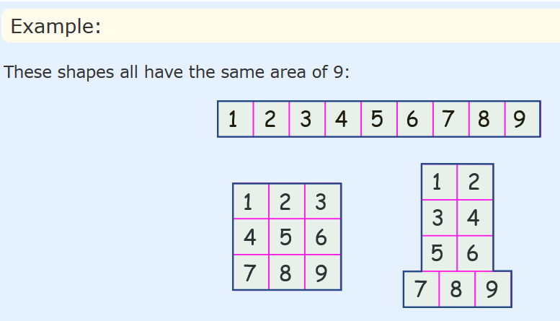
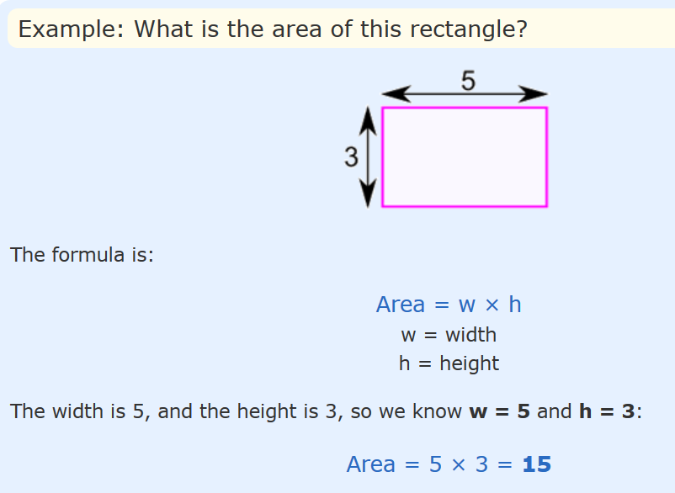
Perimeter Definition
Perimeter is the distance around a two-dimensional shape.
Area Definition
Area is the term used to define the amount of space taken up by a 2D shape or surface.
It is measured in square units : cm² or m².
Area is calculated by multiplying the length of a shape by its width.

Slide 3
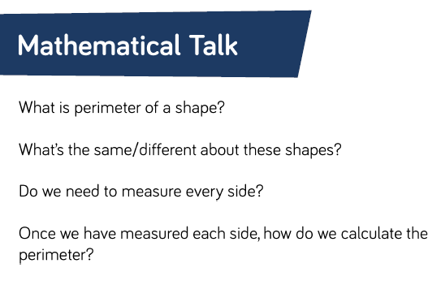

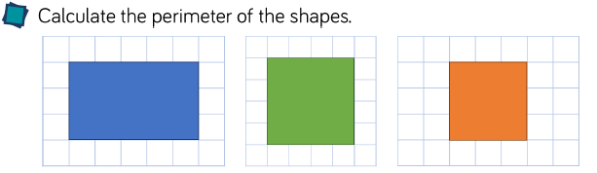
Activity 1: Perimeter Recap

Slide 4
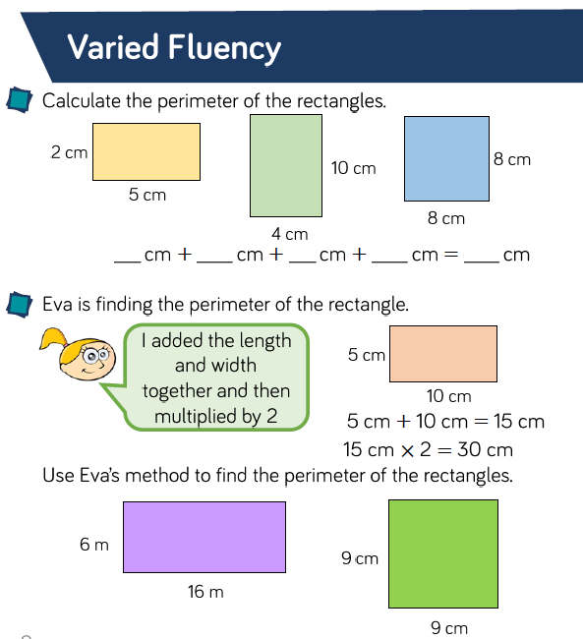
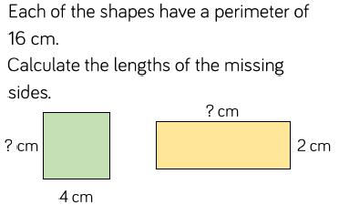

Activity 2: Perimeter Practice

Slide 5
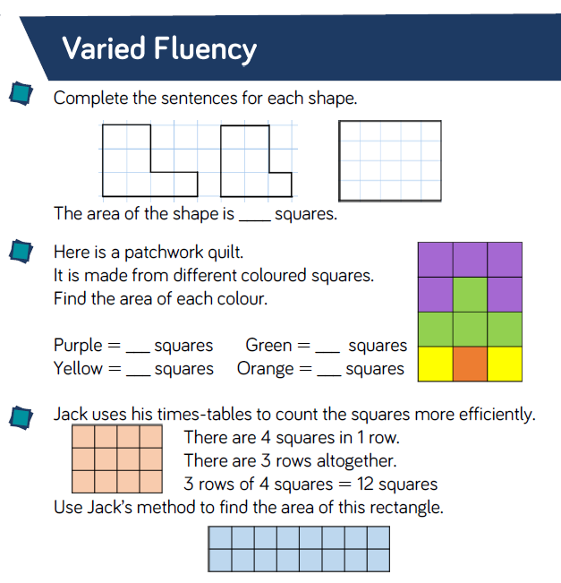
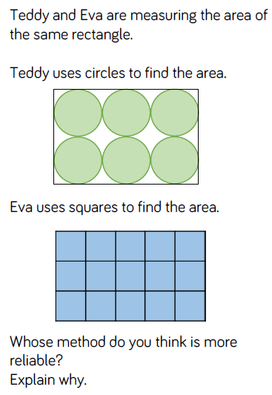
Activity 3: Area Recap

Slide 6
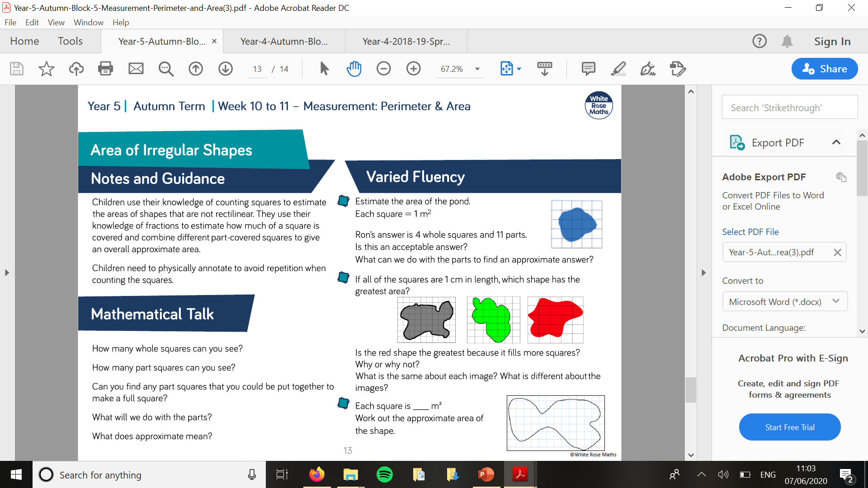
Activity 4: Area Practice

Slide 7
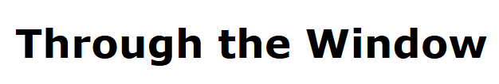
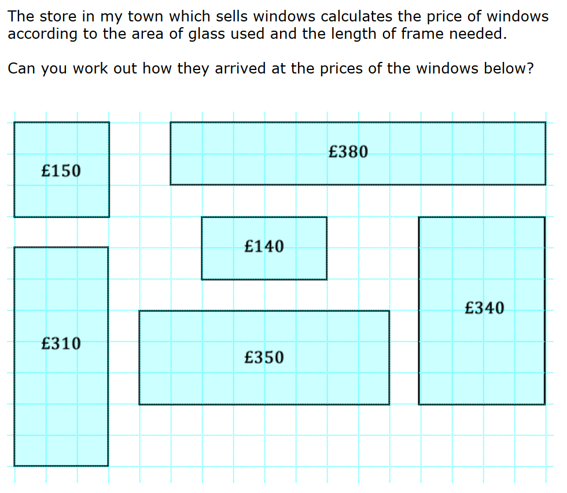
Activity 5: Investigation
Getting Started
Are there any windows that use the same amount of glass? How do their frame lengths differ?
Are there any windows that use the same amount of frame? How do their glass areas differ?
https://nrich.maths.org/10344

