Slide 1
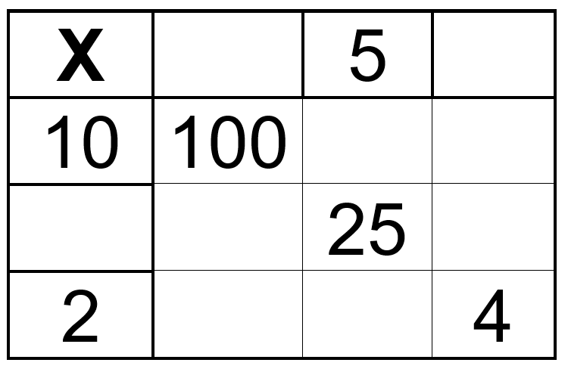
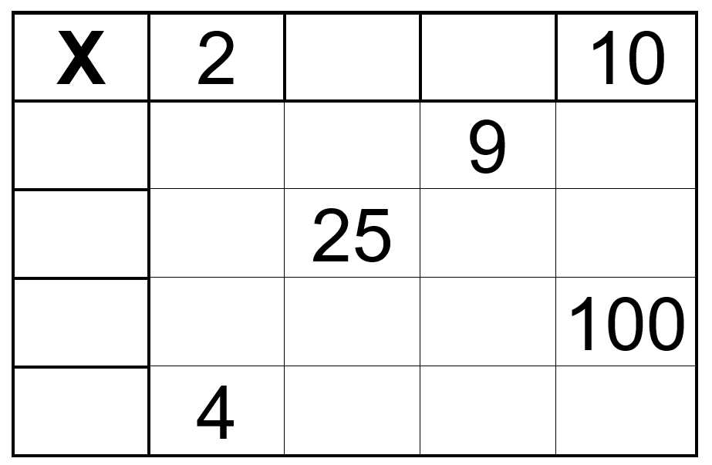
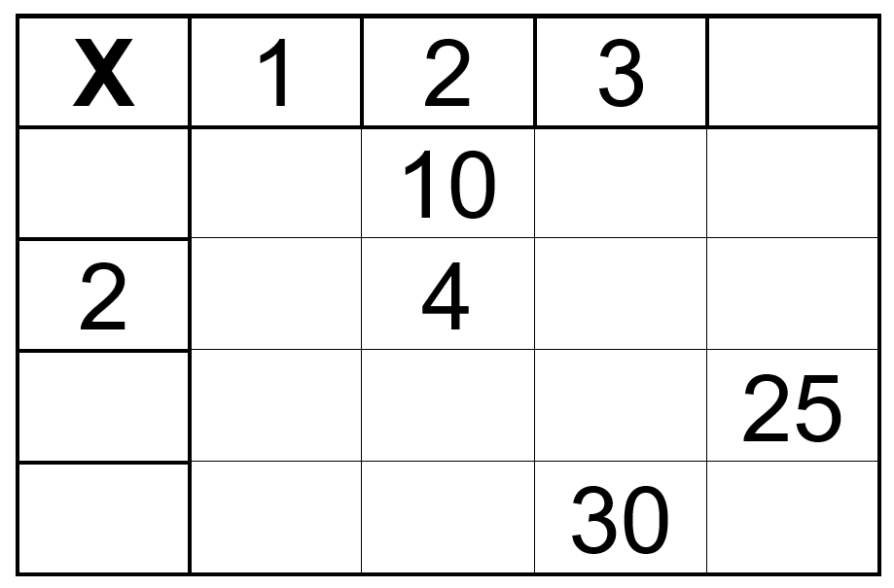
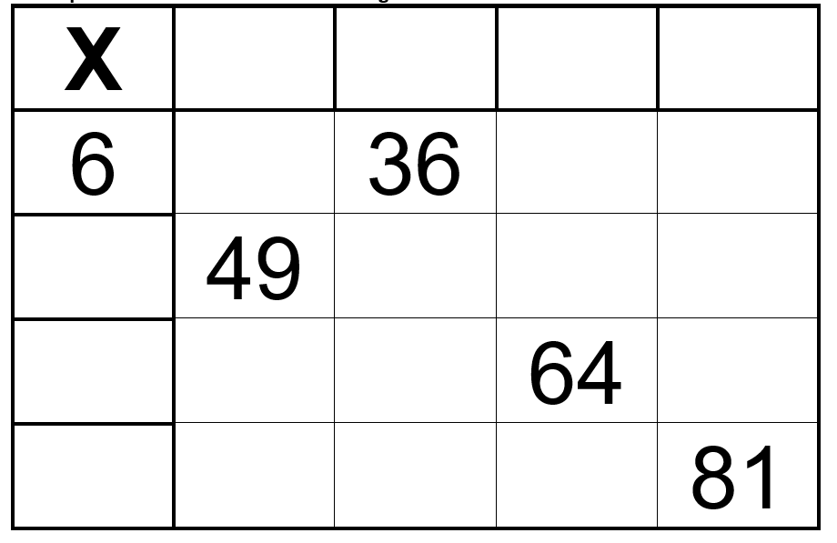
Warm Up: Times Tables

Slide 2
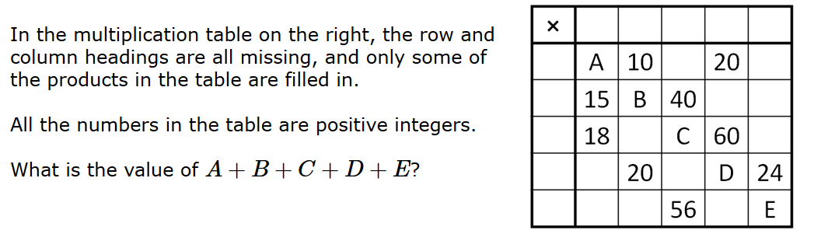
Warm Up: Times Tables
Challenge

Slide 3
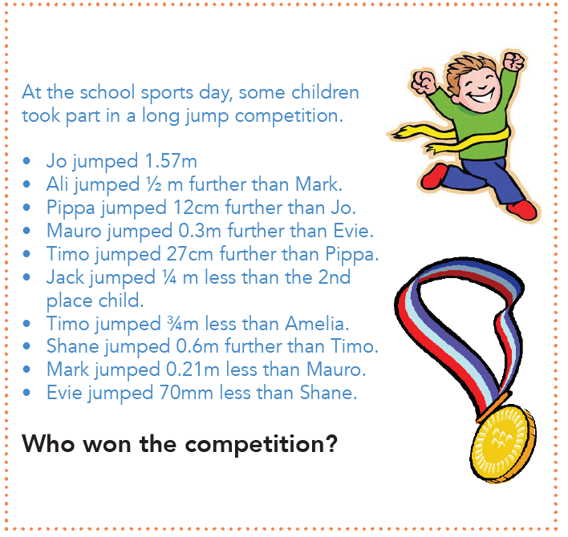
Main Event: Activity 1

Slide 4
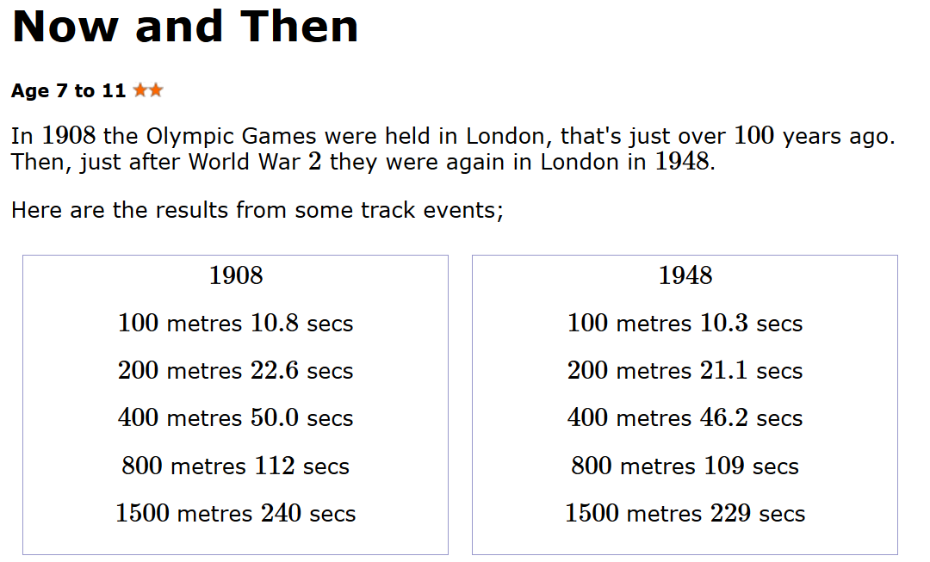
Main Event: Activity 2
Questions
Try to answer these questions in full sentences and use examples to illustrate your point.
How did the results differ from 1908 to 1948? Do you notice any patterns?
The 2012 London Olympics were another 64 years later. How do you think the results differed from 1908 and 1948?
Do you think you could have predicted the results? How would you have done this?
What do you think the results would have been for the 2016 Olympics?
https://nrich.maths.org/8171

Slide 5
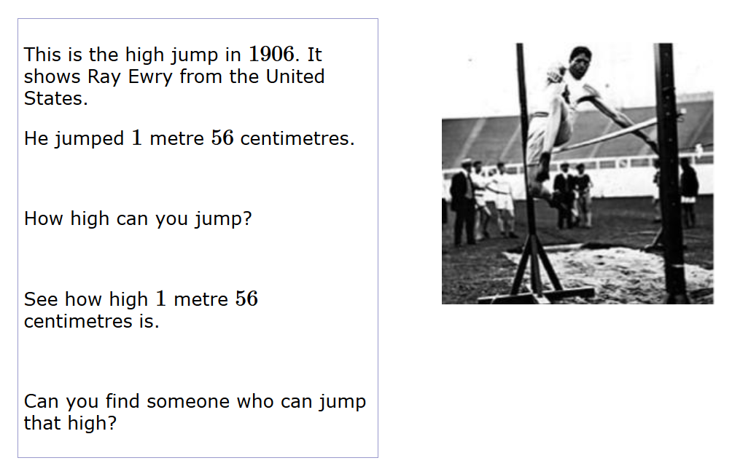
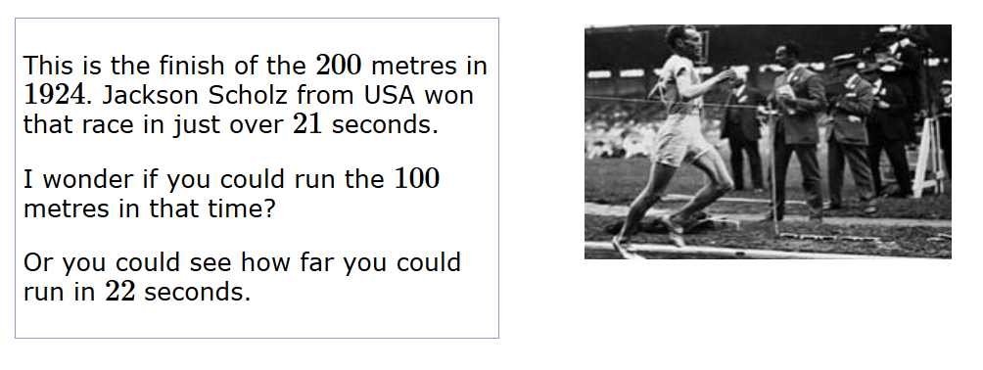
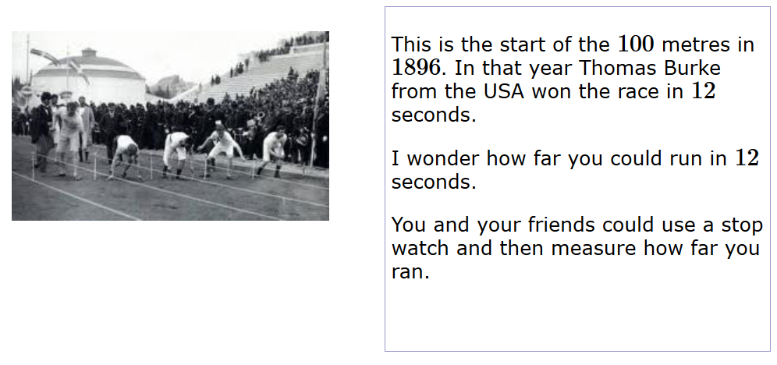
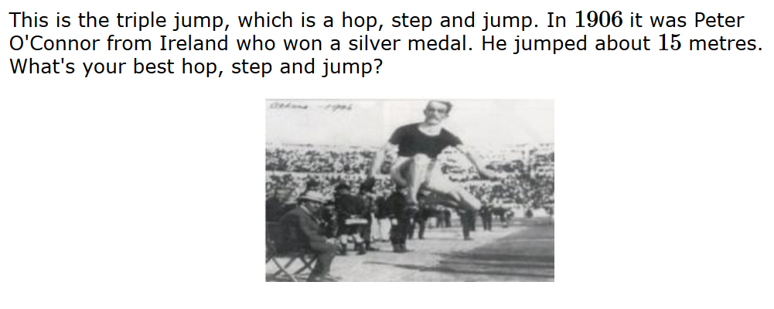
Main Event: Activity 3

Slide 6
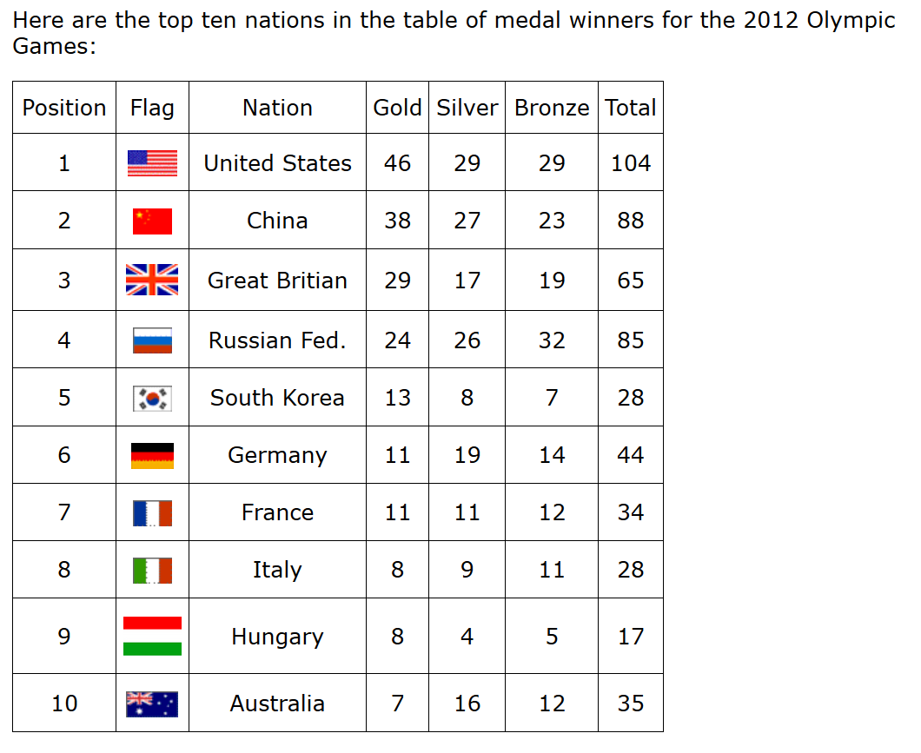
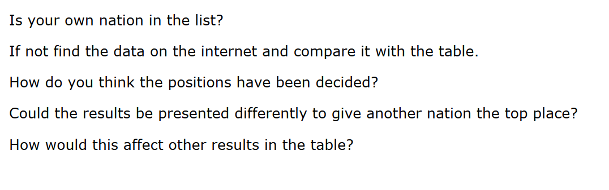
Main Event: Activity 4
https://nrich.maths.org/7800

Slide 7
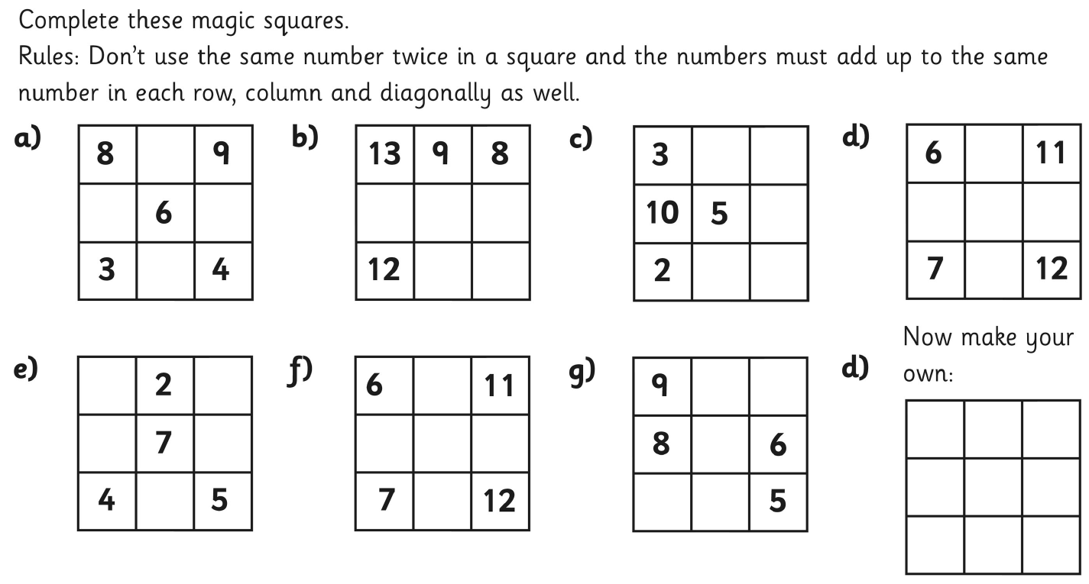
Cool Down: Puzzle

